Slide 1
THREE ACTS
An Instructional Routine
Prompting Mathematical Modeling

Slide 2
THREE ACTS
WHAT: Practice identifying problems,
quantities and relationships. Explore
assumptions, create and revise models.
WHY: to “think like mathematicians”, who model to analyze real-world situations, make predictions, and revise their thinking.
Notes:
make mathematical models that represent and make sense of a real-world situation, and analyze and make predictions.
Practice identifying problems, quantities and relationships; exploring assumptions; and creating, using, interpreting, and refining models.

Slide 3
THREE ACTS
ACT 1: Understand the Problem
ACT 2: Plan & Solve using a Model
ACT 3: Interpret Conclusions
Reflect on learning

Slide 4
ACT 1
As you look at this flyer, ask yourself...
“What do I notice?”
“What do I wonder?”
Notes:
Alternate ask yourself question: “What questions come to mind?”

Slide 5
ACT 1
Understand the Problem
I noticed ...and wondered….
What did you notice and wonder?
Notes:
If using alternate ask yourself question in SLIDE 4, then update this slide with sentence frames to reflect this. (ie “A question that comes to mind is…What question did you have?”)
After about 30 seconds of pair conversations, facilitate whole class discussion. Write down the questions that students are wondering about on the board or chart paper getting close to the question on the next slide, or identifying the one on the list closest to the one on the next slide (SLIDE 6).

Slide 6
ACT 1
Identify the Problem
???

Slide 7
ACT 1
Identify the Problem
When should we keep our free coffee card? When should we bet it?

Slide 8
ACT 1
When should we bet our free coffee?
What’s an answer that you are sure is too large? (High)
What’s an answer that you are sure is too small? (Low)
What is your best guess? (Best)
Notes:
Alternate option: write on the board or chart paper the highest high number, the lowest low number, and best guesses with student names. See if students want to share a reason for their prediction of the best guess.

Slide 9
ACT 2
Identify Quantities & Relationships
I am interested in the number/amount of… because….
What quantities are you interested in finding out? Why?
The relationship between...and...is important because….
What relationships do you think are important? Why?
Notes:
Remind students quantities are things that can be counted or measured.
Ask yourself, “What are the quantities in the situation? Which ones am I interested in? Why?” OR
“What are the important relationships in the situation? Why are they important?”
Provide information about what quantities are (Ask yourself, “What can I count or measure in this situation?”; students can state, “The number of … “ or “the amount of ….”).

Slide 10
Identify Quantities & Relationships
Share
What information would be useful to know?
How can this information be found?
Notes:
After students discuss in pairs, teacher asks class what information they want to know. Students ask the questions and teacher provides information the students seek.

Slide 11
REQUESTED INFORMATION
Notes:
If students ask for the number of taters in the bag.
Share the information after students ask for it. Answers do not need to be in the slides. You can remove this slide and use the actual video/images/answers from the resource folder as students ask for them.

Slide 12
ACT 2
Create Model
What representation will be helpful to describe the relationship(s) in your model and use it to solve the problem?
Algebraic
Geometric
Graphical
Statistical
Use a table
Notes:
Give students 3-5 minutes to work on their own to think about and start creating a model before sharing with a partner.

Slide 13
Create Model
Pair
I used…to represent…
Using...helps represent the relationship….
I connected...to the mathematics of….
My result makes sense because….
I assumed….
Notes:
Questions to ask students as they work:
What mathematics did we learn so far that can be used to make sense of this situation?

Slide 14
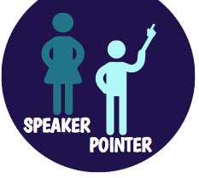
Interpret Model
Share & Study Models
“We estimated the value to be….”
“We used … to model … because ....”
“They paid attention to....in the context and connected it to….”
“Their model assumes...”
Notes:
Possible questions to ask:
What quantities are being used?
What relationship is being valued?
What assumptions do you hear?
What did they simplify? How does that affect their model?

Slide 15
Revise Model
Pair
Make edits to (ANNOTATE) your original model. Use different colors. Make notes on the new assumptions or information that were included and how that changes the result.
Ask yourself:
How does the new assumption change my model’s result?
Are there any other assumptions I want to consider?

Slide 16
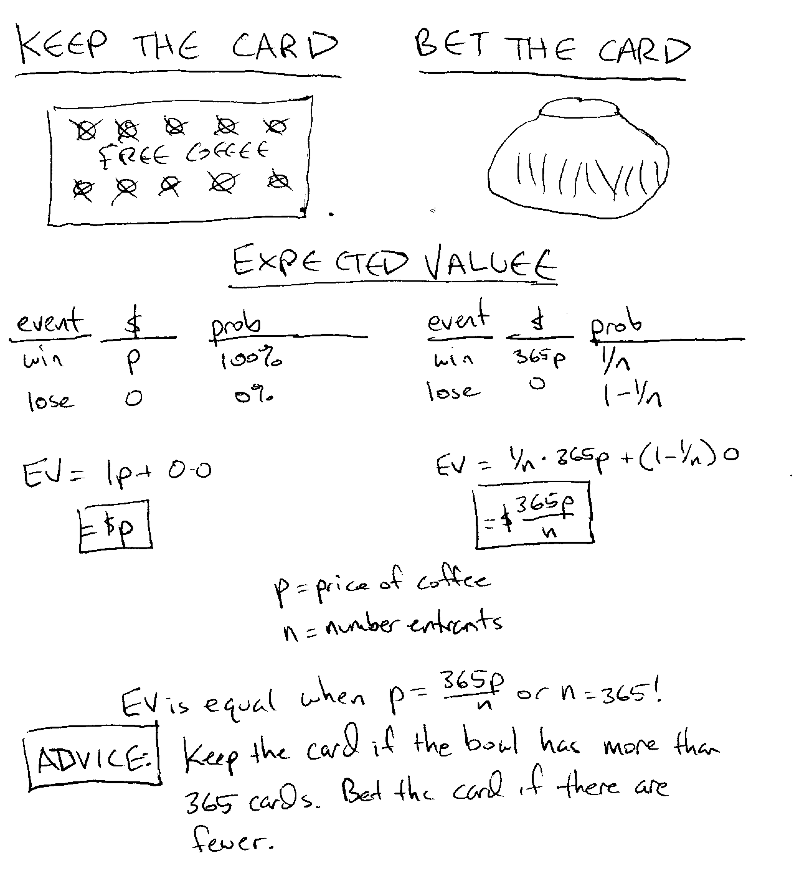
ACT 3
Notes:
Celebrate with students - who got closest???
If there is time, have the student share their model and assumptions, and any revisions they made to get closer to the result.

Slide 17
ACT 3
Revise & Report
Compare your results to the revealed result. Review your model and work.
What else do I want to revise or report?
My solution is close to (or far from) the revealed
result because I considered (or did not consider)….
My model can be (or was) improved by thinking
about...because….
The assumptions that were made were (or were not)
useful because….
Notes:
Possible alternate prompts:
My model was improved after listening to ….because….
I used to think...but now I think...so I will...

Slide 18
Reflecting on Learning
Paying attention to … in a context is helpful because...
When creating a model, thinking about...is important because….
Notes:
Alternate prompts:
When creating a model, I learned to pay attention to…
The next time I create a model, I will...because….
It’s important to think about...when analyzing a model because….

