Slide 1
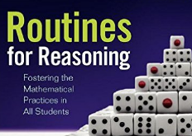
CONNECTING
REPRESENTATIONS
An Instructional Routine
Prompting Structural Thinking

Slide 2
CONNECTING REPRESENTATIONS
WHAT: Connect expressions to diagrams
WHY: To “think like mathematicians,” to
use mathematical structure to
connect two things that look
different.

Slide 3
CONNECTING REPRESENTATIONS
Think
Make Connections
Share and Study Connections
Create a Representation
Reflect on Learning

Slide 4
THINK
Ask yourself…
“How are the diagrams similar/different?”
Notes:
INSERT TYPES OF REPRESENTATIONS

Slide 5
CONNECT
“I saw … so I connected....”
“... matches … because...”

Slide 6
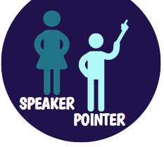
SHARE CONNECTIONS
“We saw … so we connected....”
“... matches … because...”
“They paid attention to....”
“Their match works because...”

Slide 7
Create a Representation
THINK
Ask yourself…
“What are the chunks of this expression?”

Slide 8
Create a Representation
PAIR
Share your representation.
Together agree how best to explain your thinking.

Slide 9
Create a Representation
SHARE
They paid attention to …
Their representation matches because...

Slide 10
Reflect on Learning
Paying attention to … in a diagram
is helpful because...
When interpreting an expression representing exponents, I learned to pay attention to…

