Slide 1
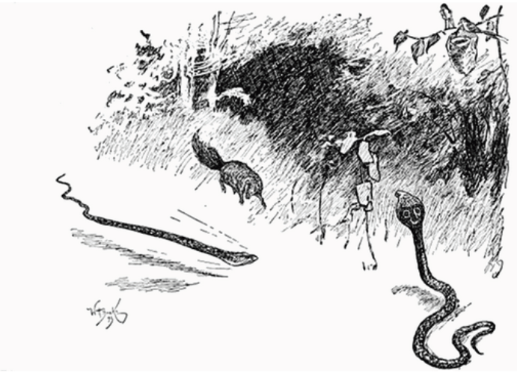
How do Rikki’s actions reveal
his character?
Notes:
The only feedback that I have to beef up this lesson, would be to consider analyzing two passages that reveal Rikki’s character that show different aspects of his character. You’ve done a great set of lessons showing his heroism, could you also analyze a passage that shows his goofy, playful side? This would then lead to the thinking that characters are more complex and can reveal different character traits within a text.
If you choose to beef this up, this question could be changed to: “How do Rikki’s actions reveal him as a complex character?” (or something like that)

Slide 2
In this lesson you will learn how to determine a character’s traits by examining his/her actions across a text.
Notes:
This objective could then become,…by examining his/her actions across a text.

Slide 3
Introduced to 3 characters at the beginning:
Rikki-tikki-tavi
Darzee, the tailor-bird
Chuchundra, the muskrat
“Rikki Tikki Tavi”
This the story of the great war that
Rikki-tikki-tavi fought single-handed, through the bath-rooms of the big
bungalow in Segowlee cantonment.
Darzee, the tailor-bird, helped him, and Chuchundra, the muskrat, who never
comes out into the middle of the floor,
but always creeps round by the wall,
gave him advice, but Rikki-tikki did
the real fighting.

Slide 4
1
List the main character’s actions across a text.
2
Analyze the actions and ask, “What do
these say about the character?”
3
Use this analysis to determine the
character’s traits.
Notes:
Step #1 could become: List the main character’s actions across a text

Slide 5
1 List the main character’s
actions across a text.
It is the hardest thing in the world to
frighten a mongoose, because he is
eaten up from nose to tail with
curiosity. The motto of all the
mongoose family is, "Run and find
out"; and Rikki-tikki was a true
mongoose. He looked at the cotton-
wool, decided that it was not good to
eat, ran all round the table, sat up
and put his fur in order, scratched
himself, and jumped on the small
boy's shoulder.
"Don't be frightened, Teddy," said his
father. "That's his way of making friends."
ran all round
the table
sat up and put his
fur in order
scratched himself
jumped on the
boy’s shoulder

Slide 6
Analyze the actions and ask, “What do these say about the character?”
Rikki’s actions:
ran all round
the table
Rikki showing his playful side.
sat up and
put his fur
in order
He likes his fur to be neat.
scratched
himself
jumped on
the boys’
shoulder
“That’s his way of making friends.”

Slide 7
1 List the main character’s
actions across a text.
Rikki’s actions:
eyes grew red and hot
sat back on tail and
hind legs
chattered with rage
didn’t follow Nag and
Nagaina
trotted off
sat down to think
Rikki-tikki felt his eyes growing red and hot (when a mongoose's eyes grow red, he is angry), and he sat back on his tail and hind legs like a little kangaroo, and looked all around him, and chattered with rage. But Nag and Nagaina had disappeared into the grass. When a snake misses its stroke, it never says anything or gives any sign of what it means to do next. Rikki-tikki did not care to follow them for he did not feel sure that he could manage two snakes at once. So he trotted off to the gravel path near the house, and sat down to think. It was a serious matter for him.
Notes:
Great slide – if you choose to analyze a second passage, two slides could come after slide #6 – in other words, keep #5 and #6 as is and do the same two slides for another passage

Slide 8
Analyze the actions and ask, “What do these say about
the character?”
Rikki’s actions:
eyes grew red and hot
sat back on tail and
hind legs
chattered with rage
didn’t follow Nag and
Nagaina
trotted off
sat down to think
(“when a mongoose's eyes grow red, he is angry”)
Rikki sits back and makes noise to show even greater anger.
Rikki leaves and takes time to think.

Slide 9
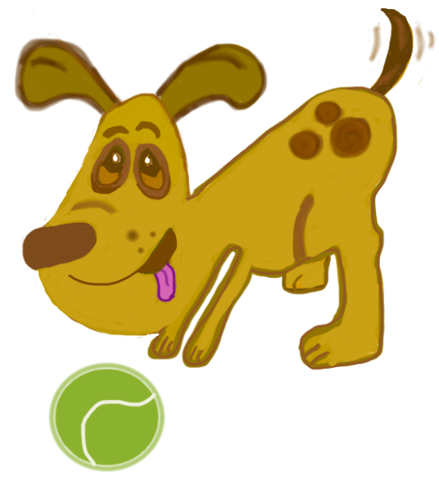
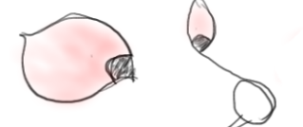
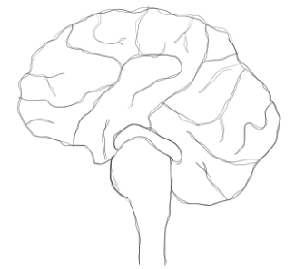
Use this analysis
to determine the
character’s traits.
Playful
Friendly
Angry
Protective
Logical
Intelligent
Serious

Slide 10
How do Rikki’s actions reveal his character?
By analyzing Rikki’s actions, the reader can tell in the first passage that Rikki has a playful side, and he is very curious to find out about his new surroundings by “running and finding out”. When he jumps on the boy’s shoulder, Rikki’s dad assures him that this is his way of making friends and that he is friendly.
In the second passage Rikki is angry and filled with rage when faced with the need to fight and protect. Rikki becomes serious and thoughtful and uses logic when problem solving to figure out his next move with the antagonist revealing his ability to demonstrate strength and courage.
When comparing these two different passages, we see that characters are complex and show us different traits depending on what they are facing.

Slide 11
1
List the main character’s actions
across a text.
2
Analyze the actions and ask, “What do
these say about the character?”
3
Use this analysis to determine the
character’s traits.

Slide 12
In this lesson you have learned how to determine a character’s traits by examining his/her actions
across a text.

